Slide 1
Module A
Unit A1
Vocabulary
Language Functions
Speaking Activities
UTN FRVM Lic. Evangelina Cecchel - Lic. Bibiana Fernandez

Slide 2
Adjectives.
Order of adjectives
UTN FRVM Lic. Evangelina Cecchel - Lic. Bibiana Fernandez

Slide 3
Look at the suffixes that help to form adjectives from nouns
Nouns Adjectives
Business businesslike
Competition competitive
Emotion emotional
injury Injured
innocence innocent
Nation national
pleasure pleasant
Shame shameful
truth truthful
UTN FRVM Lic. Evangelina Cecchel - Lic. Bibiana Fernandez

Slide 4
Cheerful
confident
depressed
energetic
exhausted
in a great mood
in a bad mood
laid-back
nervous
relaxed
tense
happy and feeling good
sure that you can do sth. well
very sad
very active
extremely tired
feeling very happy or pleased
feeling unhappy or angry
calm or relaxed
unable to relax
more calm and less worried
nervous and anxious
UTN FRVM Lic. Evangelina Cecchel - Lic. Bibiana Fernandez

Slide 5
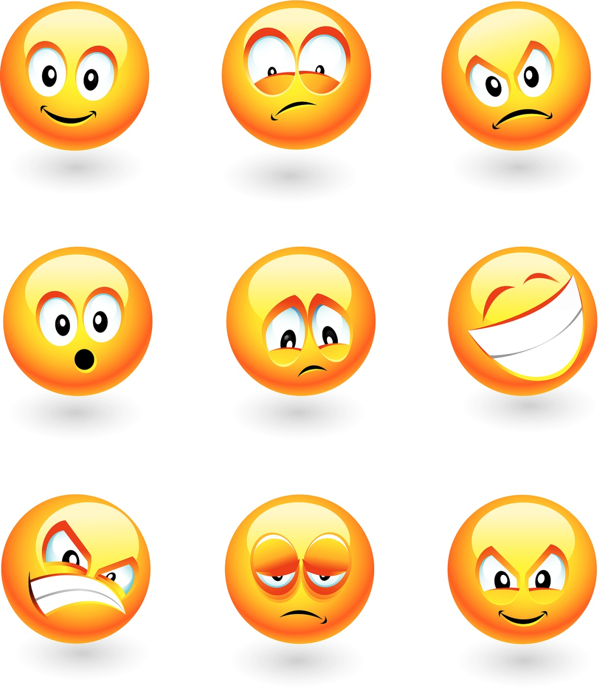
How do they feel? Why?
UTN FRVM Lic. Evangelina Cecchel - Lic. Bibiana Fernandez

Slide 6
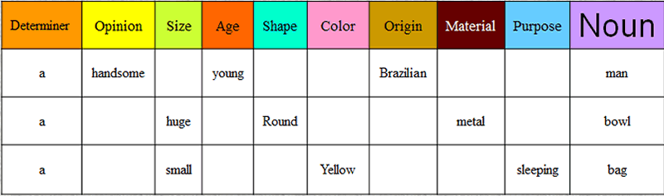
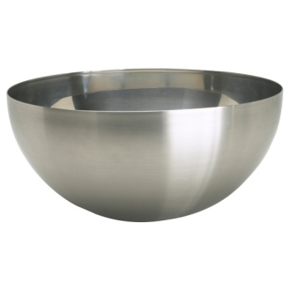

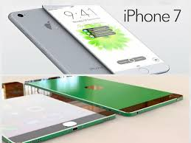
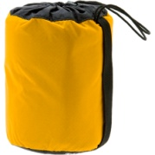
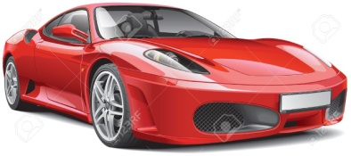

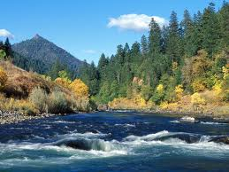
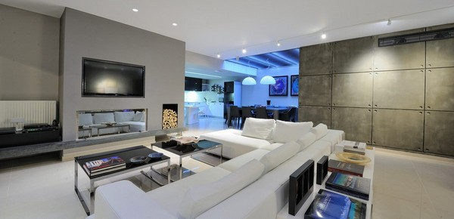
Order of adjectives: Describe the pictures.
Which of these items would you choose as a birthday present? Why?
Vocabulary link: http://www.ompersonal.com.ar/omgrammar/adjetivoscalificativos.htm
UTN FRVM Lic. Evangelina Cecchel - Lic. Bibiana Fernandez

